Slide 1
Introduction to OOP

Slide 2

Objectives
At the end of this lecture, you will be able to :
Discuss Object-Oriented approach to programming
Explain what is an Object
Explain what is a Class
Create an Object from a Class
Interpret a simple Class Diagram
Access data and methods
Notes:
Welcome to the lecture. This is an introductory lecture to OOP. At the end of this lecture, you will be able to discuss the object-oriented approach to programming. You will learn to create an object from a class based on class element diagram given as well as access the data and methods of the object.

Slide 3
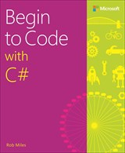
Reference
Begin to Code with C#
By Rob Miles
C# Object-Oriented Programming Tips and Tricks
https://www.linkedin.com/learning/c-sharp-object-oriented-programming-tips-and-tricks/creating-fields-and-access-modifiers?u=42538748
By Jesse Freeman
(need to login to your npnet account)

Slide 4
Object-Oriented Programming _{/1...}
Why Objects?
Notes:
Let’s first find out why objects and what are objects

Slide 5

Object-Oriented Programming _{/2...}
At the end of the day...
computers just manipulate 0’s and 1’s
But binary is hard (for humans) to work with
Notes:
All of you know that computers only understand binary code, which consist of only 0’s and 1’s. But binary code is difficult for us to read and write.

Slide 6

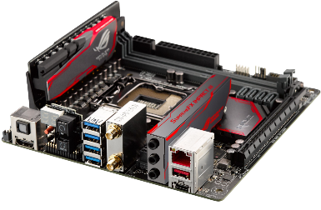
Object-Oriented Programming _{/3...}
Towards a higher level of abstraction
??
OO Languages (C++, Java, C#, Swift, Kotlin & etc)
High-level languages
Procedural languages (C, Python, Pascal & etc)
Assembly Languages
Low-level languages
Binary Code (machine language)
Notes:
Computer language continue to evolve since it was first invented. From machine language at the beginning, to assembly language, then procedural language and now object oriented language. This is mainly moved towards a higher level of abstraction where programmers do not need to know the internal implementation details but only the essential information.

Slide 7
Object-Oriented Programming _{/4...}
There are always trade-offs
High-level languages
simpler to write & understand
more library support, data structures
Low-level languages
closer to hardware
more efficient (but also dangerous!)
Notes:
However, there are always trade-offs to this evolution. Though high-level languages are simpler to write and understand, it has more library support and data structure, it may not be able to execute as fast as codes written in low-level language . Moreover, high-level language do not have direct control over tasks like memory management which low-level language is able to do

Slide 8
What are Objects?

Slide 9
What are Objects? _{/1...}
An object is an entity in the real world that can be distinctly identified
e.g. a circle, a book, a customer, a bank account, an event
Each object has:
characteristics
responsibilities (or required behaviors)
Notes:
An object is a self-contained unit in the real world, e.g. a car, a person, a book, etc. Each object has its characteristics and actions.

Slide 10
What are Objects? _{/2...}
Example,
Problem
Design and build a computer soccer game
Object
Soccer player
Characteristics
Position, height, weight, salary, number of goals
Responsibilities
Pass the ball, shoot, dash forward, dash backward, block player, etc.
Notes:
For example, if you are to design and build a computer soccer game, one important object that you need will be the soccer player. You may need many soccer players in your game, but each of them has its own characteristics such as the position, height, weight etc. Each of them also has its own action such as to pass the ball, to shoot, etc.

Slide 11
What are Objects? _{/3...}
Another example,
Problem Bike Sharing Application
Write a program that allow users to register a bike sharing portal. The user can locate nearby bikes, reserve a bike, unlock a bike and pay for the duration’s ride using credit points.
Object/s ???
Characteristics ???
Responsibilities ???
Notes:
Write a program that allow users to register a bike sharing portal. The user can locate nearby bikes, reserve a bike, unlock a bike and pay for the duration’s ride using credit points. What are the objects needed in this application? What are the characteristics and responsibilities of each object?
Objects: User, Bike, Credit Point
User:
Characteristics – Name, Bank Account
Responsibilities – ride bike, make Payment & etc
Bike:
Characteristics – 2 wheels, handle, paddle & etc
Responsibilities – broadcast GPS location, lock and unlock
Credit Point:
Characteristics – Amount, Id
Responsibilities – credit and debit

Slide 12
What are Classes?

Slide 13


What are Classes? _{/1...}
Have you seen a cookie-cutter?
A class is like a “cookie-cutter”; it defines the shape of objects
How many cookies can you make with 1 cookie-cutter?
Objects are like cookies; they are instances of the class
Notes:
A class is like a “cookie-cutter”; it defines the shape of objects. Objects are like cookies; they are instances of the class. You can cut out many cookies with one cookie cutter.

Slide 14
What are Classes? _{/2...}
Another example,
Student (Class)
Peter, John & Tom (Objects – instances of Student)
Notes:
A class is a blueprint or prototype that defines the variables and the methods common to all objects of a certain kind.
An object is a specimen of a class. Software objects are often used to model real-world objects you find in everyday life.
For example, if you have a class Student in your application, you can create may instances of Student such as Peter, John, Tom etc. Each of these is an object.

Slide 15
What are Classes? _{/3...}
Question:
Tom wanted to create a Student Class in C#, what do you think he needs? Discuss.
Well, a student usually has a Name, ID, etc.
What can this Student Class do?
Allow a program to write a name
Allow a program to read the name
Notes:
If you want to create a Student class in your application, what do you need in this class?
Of course it all depends on what is the purpose of this application. But minimally, a student usually has a name and an identification number. These are used to identify the characteristics of the objects.
The Student class should allow a program to display the name of the student or to set the name of a student. These are the actions that the object can do.

Slide 16
What are Classes? _{/4...}
Defining Class in C#,
Name of a Class
Field(s)
Property or Properties
Constructor(s)
Method(s)
Characteristics
Responsibilities
Notes:
These are the 5 items needed when defining a class in C#.
All classes need to have a name, fields and properties that defines the characteristics, and constructors and methods that defines the responsibilities or action.

Slide 17
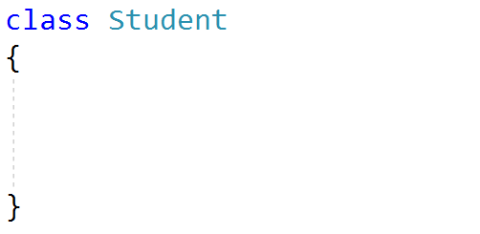
What are Classes? _{/5...}
Defining Class in C#,
Name of a Class
Fields
Property or Properties
Constructor(s)
Method(s)
Lower case
Capitalized
Notes:
The keyword class followed by the class name is used to define a class. Class names usually begin with upper case letter. Do not redefine any classes that are already defined in the C# library unless it is necessary.

Slide 18
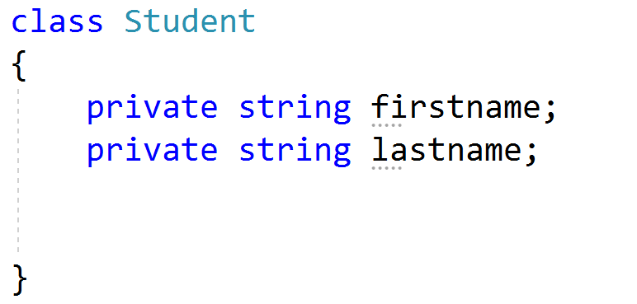
What are Classes? _{/6...}
Defining Class in C#,
Name of a Class
Field(s)
Property or Properties
Constructor(s)
Method(s)
Note: ignore encapsulation as we’ll cover this in the next lecture.
Type: e.g. int, bool, double & string
(lowercase)
Notes:
Fields are ordinary member variables of a class. Fields are declared in the class block by specifying the access level of the field, followed by the type of the field, followed by the name of the field. To respect encapsulation, fields should be kept private to a class. We will discuss more about encapsulation in the next lesson.
In our example of Student class, we defined two fields, firstname and lastname using the statements private string firstname; and private string lastname;

Slide 19
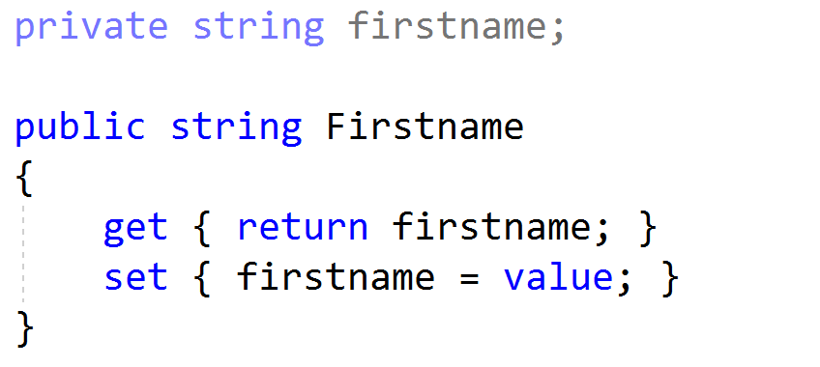
What are Classes? _{/7...}
Defining Class in C#,
Name of a Class
Fields
Property or Properties
Constructor(s)
Method(s)
Property is used to read/write information into the various fields.
lowercase
uppercase
Note: ignore encapsulation as we’ll cover this in the next lecture.
Notes:
Properties are an abstraction to get and set their values. Properties are also called accessors because they offer a way to change and retrieve a field if you expose a field in the class as private. Generally, you should declare your member variables private, then declare or define properties for them. Look at the slide to see how the property is defined for the field firstname. All that we define in the property are just a pair of get and set methods that returns the value of the field and sets the value of the field respectively.

Slide 20
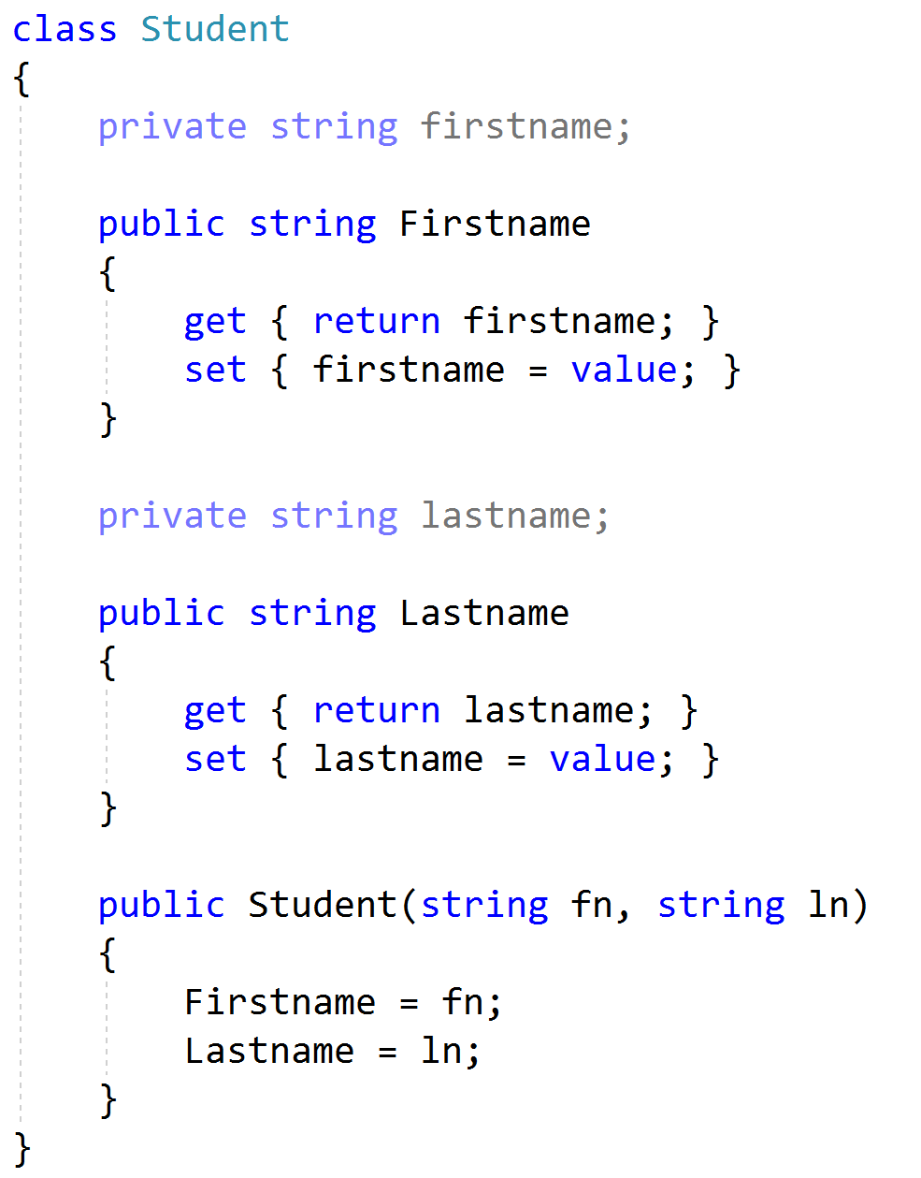
What are Classes? _{/8…}
Defining Class in C#,
Name of a Class
Field(s)
Property or Properties
Constructor(s)
Method(s)
Same name
lowercase
Notes:
Constructor is a block of code that initializes the newly created object. It looks like a method but it is in fact not a method. It’s name is the same as the class name and it does not return any value. We will discuss in detail in the next lesson how to define your constructor but for now in our Student class, the constructor takes in 2 string parameters that represent the first and last name. The body of the constructor initializes the values of the fields to these values.

Slide 21
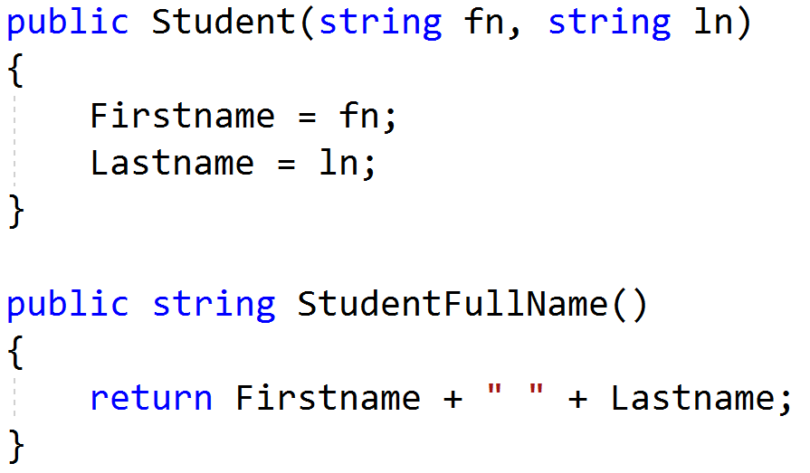
What are Classes? _{/9...}
Defining Class in C#,
Name of a Class
Field(s)
Property or Properties
Constructor(s)
Method(s)
Capitalized
Note: Commonly known as function in other programming language
Notes:
A method is a code block that contains a series of statements. A program causes the statements to be executed by calling the method and specifying any required method arguments.
Do note that the method StudentFullName() defined here is different from the methods that we learnt in the first week. The methods that we learnt in the first week are static methods, they are to be called from any statement in the Main() method without creating any object. On the other hand, StudentFullName() method is an instance method, it is to be called with an object.

Slide 22
How to create Objects
from a Class?
Notes:
How to create objects if you have already defined a class?

Slide 23
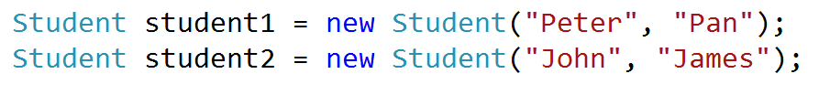
Creating an Object from a Class
To create an object from a class, invoke a constructor of the class using the new operator as follows
ClassName ObjectName = new ClassName(argument…);
Eg.
student1 object and student2 object are instances of Student Class
Notes:
To create an object from a class, call the constructor of the class using the new keyword.
E.g. if you have a Student class and the constructor of the class requires 2 strings to be passed in as the first name and last name, you can create a Student object with Peter as the first name and Pan as the last name using the expression new Student(“Peter”, “Pan”).

Slide 24
Representing a Class with
a Diagram

Slide 25
Class Diagram Fundamentals _{/1..}
A Class can be represented using the Class Element diagram in the UML notation as shown below:
Class Name
attribute1 attribute2 . . .
behavior1 behavior2 . . . . . .
Note: attributes also known as fields in C#.
Notes:
In software engineering, a class diagram in the Unified Modeling Language (UML) is a type of static structure diagram that describes the structure of a system by showing the system's classes, their attributes, behaviors and the relationships among objects. A class notation consists of three parts, namely, class name, class attributes and class behaviors.

Slide 26
Class Diagram Fundamentals _{/2..}
Example 1,
Product | Class Name
-code:int -name:string -price:double | Attributes/ Characteristics
+Product(int,string,double) +CalculateGST():double | Behaviors/ Responsibilities
- private (not accessible by other classes, only accessible by it’s own methods)
+ public (accessible by other classes)
Notes:
Minus sign is used to denote private accessibility and Plus sign denotes public accessibility.
The slide shows a class element diagram for the class Product that has 3 attributes code, name and price. The behaviours include a constructor and the CalculateGST() method.

Slide 27
Class Diagram Fundamentals _{/3..}
Example 2,
BankAccount
-accountNumber:string -accountName:string -balance:double
+BankAccount(string,string,double) +Deposit(double) +Withdraw(double) +CalculateInterest():double
Class Name
Attributes/
Characteristics
Behaviors/
Responsibilities
Notes:
The slide shows a class element diagram for the class BankAccount that has 3 attributes accountNumber, accountName and balance. The behaviours include a constructor and 3 methods, Deposit, Withdraw and CalculateInterest.

Slide 28
Class Diagram Fundamentals _{/..4}
Example 3,
Person | Class Name
-name:string -tel:string | Attributes/ Characteristics
+Person(string,string) | Behaviors/ Responsibilities
Notes:
The slide shows a class element diagram for the class Person that has 2 attributes name and tel. It has only the constructor in the behaviour.

Slide 29
Accessing data in Object
Data
can be accessed via Property
E.g. Product p1 = new Product(1001, "iPhoneX", 1088.00);
double oldPrice = p1.Price; // read (get) value
p1.Price = 888.00; // update (set) value
Product
-code:int -name:string -price:double
+Product(int,string,double) +CalculateGST():double
Notes:
As fields has private accessibility, we need to use properties to access the object’s data.
Recall the Product class shown in slide 26 that has 3 attributes code, name, price and the constructor. Our first statement creates a Product object called p1 with these attribute values, the second statement, double oldPrice = p1.Price; gets the value of the attribute price by using the get property Price and store it in the variable oldPrice. The third statement, p1.Price = 888; sets the attribute price to 888 using the set property.

Slide 30
Accessing methods in Object
Methods
can be accessed directly
accessed using the dot (.) operator
E.g.
double gst = p1.CalculateGST();
Console.WriteLine("GST of p2 = " + p2.CalculateGST());
Product
-code:int -name:string -price:double
+Product(int,string,double) +CalculateGST():double
Notes:
To access the methods in the object, the dot operator is to be used.
Recall again the Product class shown in slide 26 that has a method CalculateGST() that calculates and returns the GST. The first statement, double gst = p1.CalculateGST(); calculates the GST of the object p1 and assigns it to the variable gst.

Slide 31
Activities

Slide 32
Activity 1 _{/1…}
The C# code for the following SalesEmployee class is given on the next two slides.
SalesEmployee
-id:int -name:string -basicSalary:double -sales: double
+SalesEmployee(int,string,double,double)
Write code in the program class to create a list, employeeList with the given values and display the content of the list on the console.
101 Angie 1200 15000 | 105 Cindy 1000 12000 | 108 David 1500 20000 | 112 Jason 3000 30000 | 127 Vivian 2000 25000

Slide 33
Activity 1 _{/2...}
class SalesEmployee
{
// attributes and properties
private int id;
public int Id
{
get { return id; }
set { id = value; }
}
private string name;
public string Name
{
get { return name; }
set { name = value; }
}
private double basicSalary;
public double BasicSalary
{
get { return basicSalary; }
set { basicSalary = value; }
}
private double sales;
public double Sales
{
get { return sales; }
set { sales = value; }
}

Slide 34
Activity 1 _{/3...}
// constructor
public SalesEmployee(int i, string n, double bSalary, double s)
{
Id = i;
Name = n;
BasicSalary = bSalary;
Sales = s;
}
}

Slide 35
Activity 1 _{/4...} [ Program.cs ]
using System.Collections.Generic; // for List
…
class Program
{
static void Main(string[] args)
{
List<SalesEmployee> employeeList = new List<SalesEmployee>();
employeeList.Add(new SalesEmployee(101, "Angie", 1200, 15000));
employeeList.Add(new SalesEmployee(105, "Cindy", 1000, 12000));
employeeList.Add(new SalesEmployee(108, "David", 1500, 20000));
employeeList.Add(new SalesEmployee(112, "Jason", 3000, 30000));
employeeList.Add(new SalesEmployee(127, "Vivian", 2000, 25000));
Console.WriteLine("{0,-5} {1,-10} {2,-12} {3,12}", "Id", "Name", "Basic Salary",
"Sales");
for (int i = 0; i < employeeList.Count; i++)
{
SalesEmployee s = employeeList[i];
Console.WriteLine("{0,-5} {1,-10} {2,-12:0.00} {3,-12:0.00}",
s.Id, s.Name, s.BasicSalary, s.Sales);
}
}
}

Slide 36
Activity 2 _{/1...}
Given the class element diagram for FPStudent:
Write the FPStudent class
FPStudent
–studentID:string –ca1:double –ca2:double –assignment: double
+FPStudent(string,double,double,double) +CalculateFinalMark(): double
Notes:
Let’s try to do a simple activity.
Create a Console App project using Visual Studio.
Define the FPStudent class based on the class diagram given. You may refer to the solution given in slides 37 & 38 if you are stuck.

Slide 37
Activity 2 _{/2...}
class FPStudent
{
// attributes and properties
private string studentID;
public string StudentID
{
get { return studentID; }
set { studentID = value; }
}
private double ca1;
public double Ca1
{
get { return ca1; }
set { ca1 = value; }
}
private double ca2;
public double Ca2
{
get { return ca2; }
set { ca2 = value; }
}
private double assignment;
public double Assignment
{
get { return assignment; }
set { assignment = value; }
}

Slide 38
Activity 2 _{/3...}
// constructor
public FPStudent(string id, double ca1, double ca2, double asg)
{
StudentID = id;
Ca1 = ca1;
Ca2 = ca2;
Assignment = asg;
}
// other method
public double CalculateFinalMark()
{
double final = Ca1 * 0.3 + Ca2 * 0.3 + Assignment * 0.4;
return final;
}
}

Slide 39
Activity 2 _{/4...}
Write code in the main program (Program.cs) to
prompt user for the following input for 1 student: student ID, ca1, ca2 and assignment marks,
create a student object with the information entered, and
calculate and display the final mark as shown below:
Enter student ID: 10203344B
Enter CA1 mark: 68
Enter CA2 mark: 72
Enter ASG mark: 82
Final mark: 74.8
Notes:
Next switch to the Program class and write code to perform these 3 tasks.
Solution for the first task is given in slide 40. You may refer to it if you have problem.

Slide 40
Activity 2 _{/5...} [ Program.cs ]
class Program
{
static void Main(string[] args)
{
Console.Write("Enter student ID: ");
string id = Console.ReadLine();
Console.Write("Enter CA1 mark: ");
double ca1 = Convert.ToDouble(Console.ReadLine());
Console.Write("Enter CA2 mark: ");
double ca2 = Convert.ToDouble(Console.ReadLine());
Console.Write("Enter ASG mark: ");
double asg = Convert.ToDouble(Console.ReadLine());
FPStudent student1 = new FPStudent(id, ca1, ca2, asg);
double finalMark = student1.CalculateFinalMark();
Console.WriteLine("Final mark: {0}", finalMark.ToString("0.0"));
Console.ReadKey();
}
}

Slide 41
Activity 2 _{/6...}
Can you add part 2 and 3 to Program.cs in Activity 2?
Part 2
Create 3 students with your choice of data, store the 3 students in a list, calculate and print the final marks.
Part 3
Read students’ data from a file, store them in a list, calculate and print the final mark. [create a csv file, named as StudentMarks.csv, yourself that contains a list of student data: student ID, marks for ca1, ca2 and assignment]
You should make use of methods to initialize the list (one for part 2, one for part 3) and display output (both part 2 and part 3 can call the same method)
Notes:
Can you add the solutions for parts 2 and 3 yourself?

Slide 42
Activity 2 _{/6...} Sample Output
Part 2
Student ID CA1 CA2 ASG Final
10011122C 72.5 80.0 80.0 77.8
10013355B 77.0 88.5 74.0 79.3
10012356H 55.0 66.0 77.0 67.1
Part 3
Student ID CA1 CA2 ASG Final
10208278E 65.0 78.0 81.0 75.3
10209202A 72.0 68.0 75.0 72.0
10209339H 58.0 67.0 72.0 66.3
10209505A 63.0 55.0 68.0 62.6

Slide 43
Summary
Object-Oriented approach to programming
Objects
Classes
Creating an Object from a Class
Class Diagram fundamentals
Accessing data in Object
Accessing methods in Object

